Slide 1
Network Layer
Network Layer: the most complex layer
  Requires the coordinated actions of multiple, geographically distributed network elements (switches & routers)
  Must be able to deal with very large scales
    Billions of users (people & communicating devices)
  Biggest Challenges
    Addressing: where should information be directed to?
    Routing: what path should be used to get information there?

Slide 2
Network Layer Functions
Essential
Routing: mechanisms for determining the set of best paths for routing packets requires the collaboration of network elements
Forwarding: transfer of packets from NE inputs to outputs
Priority & Scheduling: determining order of packet transmission in each NE
Optional: congestion control, segmentation & reassembly, security

Slide 3
Routing in Packet Networks
1
3
6
4
2
Node
(switch or router)
5
Three possible (loopfree) routes from 1 to 6:
  1-3-6, 1-4-5-6, 1-2-5-6
Which is “best”?
  Min delay? Min hop? Max bandwidth? Min cost? Max reliability?

Slide 4
Creating the Routing Tables
Need information on state of links
  Link up/down; congested; delay or other metrics
Need to distribute link state information using a routing protocol
  What information is exchanged? How often?
  Exchange with neighbors; Broadcast or flood
Need to compute routes based on information
  Single metric; multiple metrics
  Single route; alternate routes

Slide 5
Routing Algorithm Requirements
Responsiveness to changes
  Topology or bandwidth changes, congestion
  Rapid convergence of routers to consistent set of routes
  Freedom from persistent loops
Optimality
  Resource utilization, path length
Robustness
  Continues working under high load, congestion, faults, equipment failures, incorrect implementations
Simplicity
  Efficient software implementation, reasonable processing load

Slide 6
Centralized vs Distributed Routing
Centralized Routing
  All routes determined by a central node
  All state information sent to central node
  Problems adapting to frequent topology changes
  Does not scale
Distributed Routing
  Routes determined by routers using distributed algorithm
  State information exchanged by routers
  Adapts to topology and other changes
  Better scalability

Slide 7
Static vs Dynamic Routing
Static Routing
  Set up manually, do not change; requires administration
  Works when traffic predictable & network is simple
  Used to override some routes set by dynamic algorithm
  Used to provide default router
Dynamic Routing
  Adapt to changes in network conditions
  Automated
  Calculates routes based on received updated network state information

Slide 8
Shortest Paths & Routing
Many possible paths connect any given source and to any given destination
Routing involves the selection of the path to be used to accomplish a given transfer
Typically it is possible to attach a cost or distance to a link connecting two nodes
Routing can then be posed as a shortest path problem

Slide 9
Routing Metrics
Means for measuring desirability of a path
Path Length = sum of costs or distances
Possible metrics
  Hop count: rough measure of resources used
  Reliability: link availability; BER
  Delay: sum of delays along path; complex & dynamic
  Bandwidth: “available capacity” in a path
  Load: Link & router utilization along path
  Cost: $$$

Slide 10
Shortest Path Approaches
Distance Vector Protocols
Neighbors exchange list of distances to destinations
Best next-hop determined for each destination
Ford-Fulkerson (distributed) shortest path algorithm
Link State Protocols
Link state information flooded to all routers
Routers have complete topology information
Shortest path (& hence next hop) calculated
Dijkstra (centralized) shortest path algorithm

Slide 11
Distance Vector
Local Signpost
Direction
Distance
Routing Table
For each destination list:
Next Node
Distance
Table Synthesis
Neighbors exchange table entries
Determine current best next hop
Inform neighbors
  Periodically
  After changes
dest
next
dist

Slide 12
Shortest Path to SJ
Focus on how nodes find their shortest path to a given destination node, i.e. SJ
San
Jose
D_{j}
C_{ij}
j
i
D_{i}
If D_{i} is the shortest distance to SJ from i
and if j is a neighbor on the shortest path, then D_{i} = C_{ij} + D_{j}

Slide 13
But we don’t know the shortest paths
i only has local info
from neighbors
San
Jose
D_{j'}
j'
C_{ij'}
D_{j}
C_{ij}
j
i
C_{ij”}
Pick current
shortest path
D_{i}
j"
D_{j"}

Slide 14

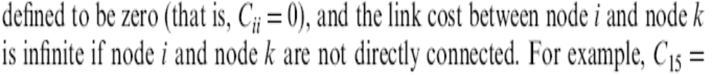
Bellman-Ford Algorithm

Slide 15
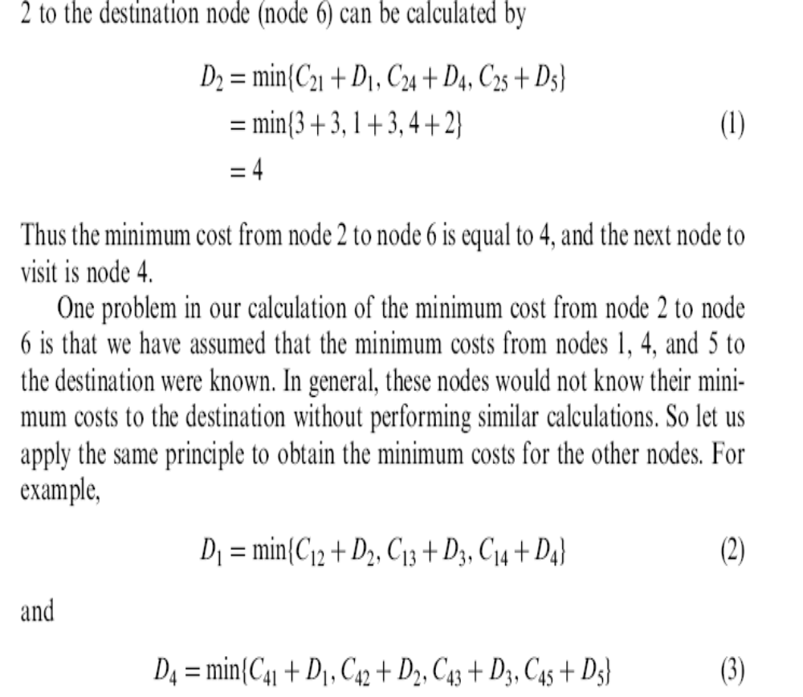

Slide 16
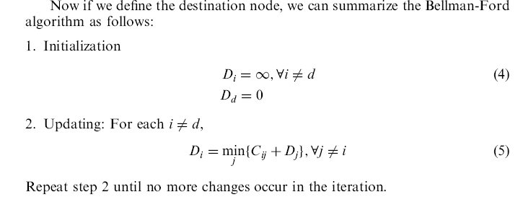

Slide 17
Iteration | Node 1 | Node 2 | Node 3 | Node 4 | Node 5
Initial | (-1, ∞) | (-1, ∞) | (-1, ∞) | (-1, ∞) | (-1, ∞)
1
2
3
Table entry
@ node 1
for dest SJ
Table entry
@ node 3
for dest SJ
2
3
1
San
Jose
1
5
2
4
3
1
3
6
2
5
2
4

Slide 18
Iteration | Node 1 | Node 2 | Node 3 | Node 4 | Node 5
Initial | (-1, ∞) | (-1, ∞) | (-1, ∞) | (-1, ∞) | (-1, ∞)
1 | (-1, ∞) | (-1, ∞) | (6,1) | (-1, ∞) | (6,2)
2
3
D₃=D₆+1
n₃=6
1
D₆=0
2
3
1
1
5
2
0
4
San
Jose
3
1
3
6
2
5
2
4
2
D₅=D₆+2
n₅=6
D₆=0

Slide 19
Iteration | Node 1 | Node 2 | Node 3 | Node 4 | Node 5
Initial | (-1, ∞) | (-1, ∞) | (-1, ∞) | (-1, ∞) | (-1, ∞)
1 | (-1, ∞) | (-1, ∞) | (6, 1) | (-1, ∞) | (6,2)
2 | (3,3) | (5,6) | (6, 1) | (3,3) | (6,2)
3
3
1
2
3
1
1
5
2
3
0
4
San
Jose
3
1
3
6
2
5
2
6
4
2

Slide 20
Iteration | Node 1 | Node 2 | Node 3 | Node 4 | Node 5
Initial | (-1, ∞) | (-1, ∞) | (-1, ∞) | (-1, ∞) | (-1, ∞)
1 | (-1, ∞) | (-1, ∞) | (6, 1) | (-1, ∞) | (6,2)
2 | (3,3) | (5,6) | (6, 1) | (3,3) | (6,2)
3 | (3,3) | (4,4) | (6, 1) | (3,3) | (6,2)
1
3
2
3
1
1
5
2
3
0
4
San
Jose
3
1
3
6
2
5
2
4
6
4
2

Slide 21
Counting to Infinity Problem
(a)
1
2
3
4
Nodes believe best path is through each other
(Destination is node 4)
1
1
1
(b)
1
2
3
X
4
1
1
Update | Node 1 | Node 2 | Node 3
Before break | (2,3) | (3,2) | (4, 1)
After break | (2,3) | (3,2) | (2,3)
1 | (2,3) | (3,4) | (2,3)
2 | (2,5) | (3,4) | (2,5)
3 | (2,5) | (3,6) | (2,5)
4 | (2,7) | (3,6) | (2,7)
5 | (2,7) | (3,8) | (2,7)
… | … | … | …

Slide 22
Split Horizon with Poison Reverse
(a)
1
2
3
4
1
1
1
Nodes believe best path is through each other
(b)
1
2
3
X
4
1
1
Update | Node 1 | Node 2 | Node 3
Before break | (2, 3) | (3, 2) | (4, 1)
After break | (2, 3) | (3, 2) | (-1, ∞) | Node 2 advertizes its route to 4 to node 3 as having distance infinity; node 3 finds there is no route to 4
1 | (2, 3) | (-1, ∞) | (-1, ∞) | Node 1 advertizes its route to 4 to node 2 as having distance infinity; node 2 finds there is no route to 4
2 | (-1, ∞) | (-1, ∞) | (-1, ∞) | Node 1 finds there is no route to 4

Slide 23
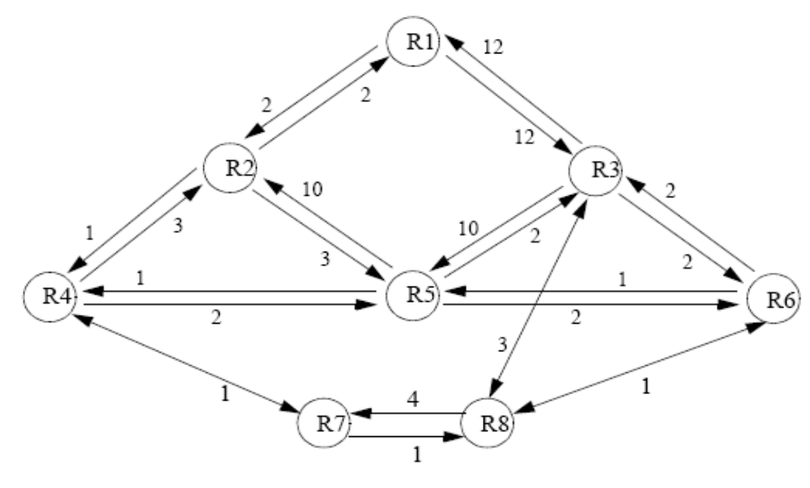
Find the shortest path for the destination R1

Slide 24
Link-State Algorithm
Basic idea: two step procedure
  Each source node gets a map of all nodes and link metrics (link state) of the entire network
  Find the shortest path on the map from the source node to all destination nodes
Broadcast of link-state information
  Every node i in the network broadcasts to every other node in the network:
    ID’s of its neighbors: N_{i}=set of neighbors of i
    Distances to its neighbors: {C_{ij} | j ∈N_{i}}
  Flooding is a popular method of broadcasting packets

Slide 25
Dijkstra Algorithm: Finding shortest paths in order
Find shortest paths from source s to all other destinations
Closest node to s is 1 hop away
2nd closest node to s is 1 hop
away from s or w”
3rd closest node to s is 1 hop
away from s, w”, or x
w'
w'
z
w
x
x
s
z'
w"
w"
x'

Slide 26
Dijkstra’s algorithm
N: set of nodes for which shortest path already found
Initialization: (Start with source node s)
  N = {s}, D_{s} = 0, “s is distance zero from itself”
  D_{j}=C_{sj} for all j ≠ s, distances of directly-connected neighbors
Step A: (Find next closest node i)
  Find i ∉ N such that
  D_{i} = min Dj for j ∉ N
  Add i to N
  If N contains all the nodes, stop
Step B: (update minimum costs)
  For each node j ∉ N
  D_{j} = min (D_{j}, D_{i}+C_{ij})
  Go to Step A
Minimum distance from s to j through node i in N

Slide 27
Execution of Dijkstra’s algorithm
✓
2
2
2
2
2
2
1
2
1
1
3
3
1
3
1
3
3
1
1
3
3
3
3
3
3
3
1
1
1
1
1
1
1
✓
6
6
6
6
6
6
6
5
5
5
5
5
5
2
5
2
2
2
2
2
2
3
3
3
3
3
3
3
✓
4
4
4
4
4
1
4
4
1
1
2
1
2
2
1
2
1
2
1
2
2
3
3
3
3
3
2
3
3
2
2
2
2
2
2
5
5
✓
5
5
5
4
5
5
4
4
4
4
4
4
Iteration | N | D₂ | D₃ | D₄ | D₅ | D₆
Initial | {1} | 3 | 2 | 5 | ∝ | ∝
1 | {1,3} | 3 | 2 | 4 | ∝ | 3
2 | {1,2,3} | 3 | 2 | 4 | 7 | 3
3 | {1,2,3,6} | 3 | 2 | 4 | 5 | 3
4 | {1,2,3,4,6} | 3 | 2 | 4 | 5 | 3
5 | {1,2,3,4,5,6} | 3 | 2 | 4 | 5 | 3
✓
✓
✓
✓
✓

Slide 28
Shortest Paths in Dijkstra’s Algorithm
2
3
1
2
3
1
1
1
3
6
6
5
2
5
2
3
3
1
4
2
1
4
2
3
3
2
2
4
5
4
5
2
3
1
2
3
1
1
3
1
3
6
6
5
2
5
2
3
3
1
4
2
1
4
2
3
3
2
2
4
5
4
5
2
3
1
2
3
1
1
3
1
3
6
6
5
2
5
2
3
3
1
4
2
1
4
2
3
3
2
2
4
5
4
5

Slide 29
Shortest path tree from node 1 to other nodes
2
3
1
1
3
6
2
3
4
2
2
5
Routing table at node 1
Advertiser ID | Destination | Next node | Cost
1 | 2 | 2 | 3
1 | 3 | 3 | 2
1 | 4 | 3 | 4
1 | 5 | 3 | 5
1 | 6 | 3 | 3

Slide 30
Reaction to Failure
If a link fails,
  Router sets link distance to infinity & floods the network with an update packet
  All routers immediately update their link database & recalculate their shortest paths
  Recovery very quick
But watch out for old update messages
  Add time stamp or sequence # to each update message
  Check whether each received update message is new
  If new, add it to database and broadcast
  If older, send update message on arriving link

Slide 31
Why is Link State Better?
Fast, loopless convergence
Support for precise metrics, and multiple metrics if necessary (throughput, delay, cost, reliability)
Support for multiple paths to a destination
  algorithm can be modified to find best two paths

Slide 32
Comparison of Distance vector and link state routing protocols
DISTANCE VECTOR ROUTING | LINK STATE ROUTING
Floods routing info only to its neighbors periodically. | Floods routing info to all the nodes in the internetwork periodically.
Floods only portion of the routing table to its neighbors | Floods only portion of the routing table
Router sends large updates to its neighbors. | Each router sends small updates to all the nodes.
Each node knows only about its neighbors. | Each node builds the map of entire network (knows about all nodes)
Routing Algorithm Converge takes more time. | Routing Algorithm Converge more quickly
More prone to routing loops | Less prone to routing loops
Less CPU power and memory. | Requires more CPU power and memory
Less expensive to implement and support | More expensive to implement and support
Less scalable. | More scalable
Implements Distributed routing algorithm(Bellman Ford algo) | Implements centralized routing algorithm(Dijstra’s algo)

